Slide 1
Project - 2
Data wrangling

Slide 2
INTRODUCTION
Data wrangling, also known as data munging, refers to the process of cleaning, transforming, and organizing raw data into a structured and usable format for analysis. It involves several steps and techniques to ensure that the data is accurate, consistent, and ready for use in various applications, such as data analysis, machine learning, and business intelligence.

Slide 3
Steps for Data Wrangling
Data Collection
Data Cleaning
Data Transformation
Data Integration
Data Formatting

Slide 4
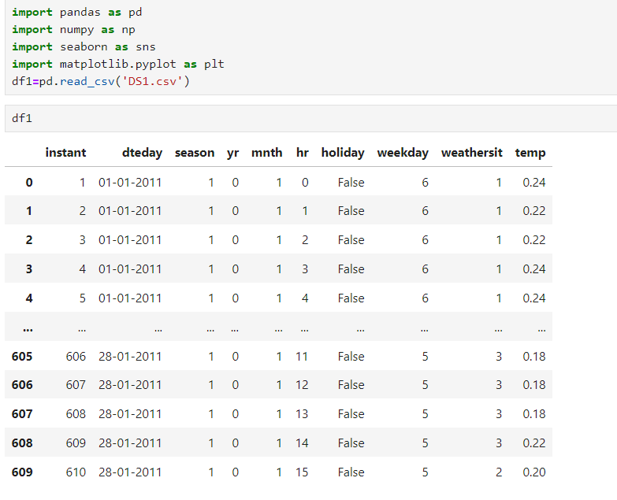
Importing important library and reading data file
Libraries plays important role in data wrangling
Libraries such as
-pandas
-numpy
-seaborn
-matplotlib

Slide 5
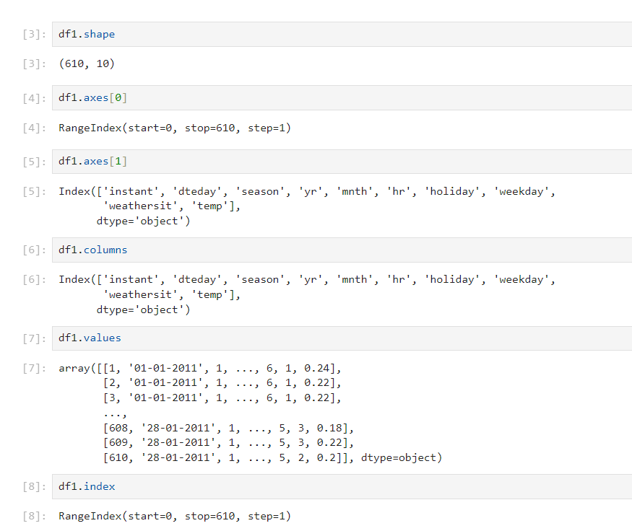
Checking basic attributes
Here we use different function to know different attributes of a data set.
-shape
-axes
-Columns
-values
-index

Slide 6
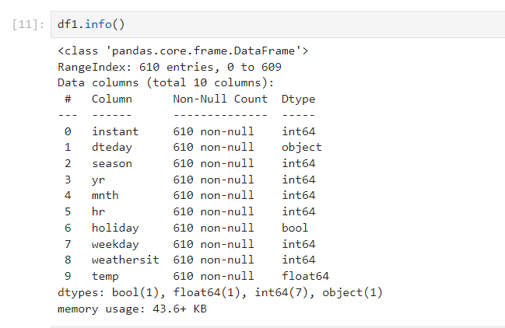
Other important attributes
Info
Describe
Null
duplicates

Slide 7
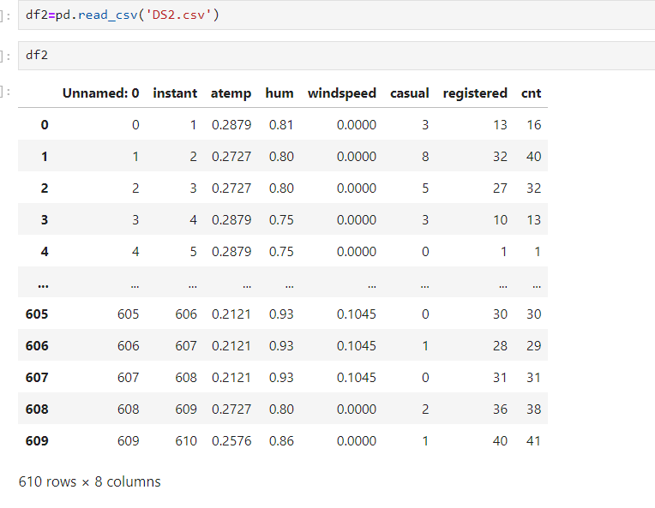
Reading second database

Slide 8
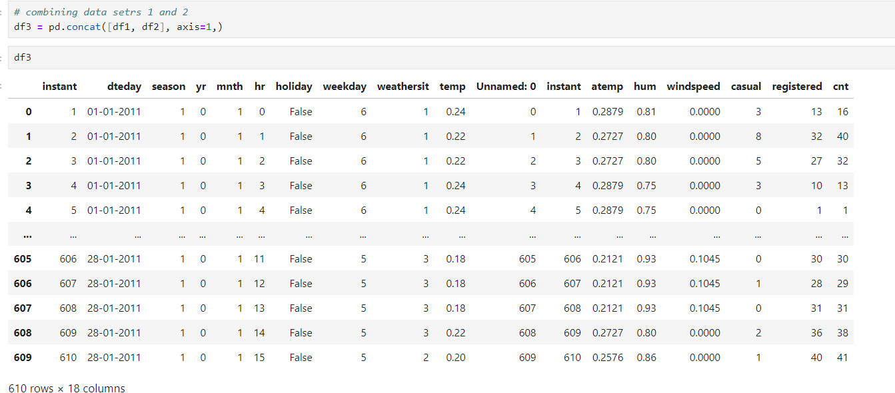
COMBINING 1 & 2 DATASETS
Here we are using concat function to concatenate 2 different data sets

Slide 9

Removing unnecessary columns and filling null values/missing values

Slide 10

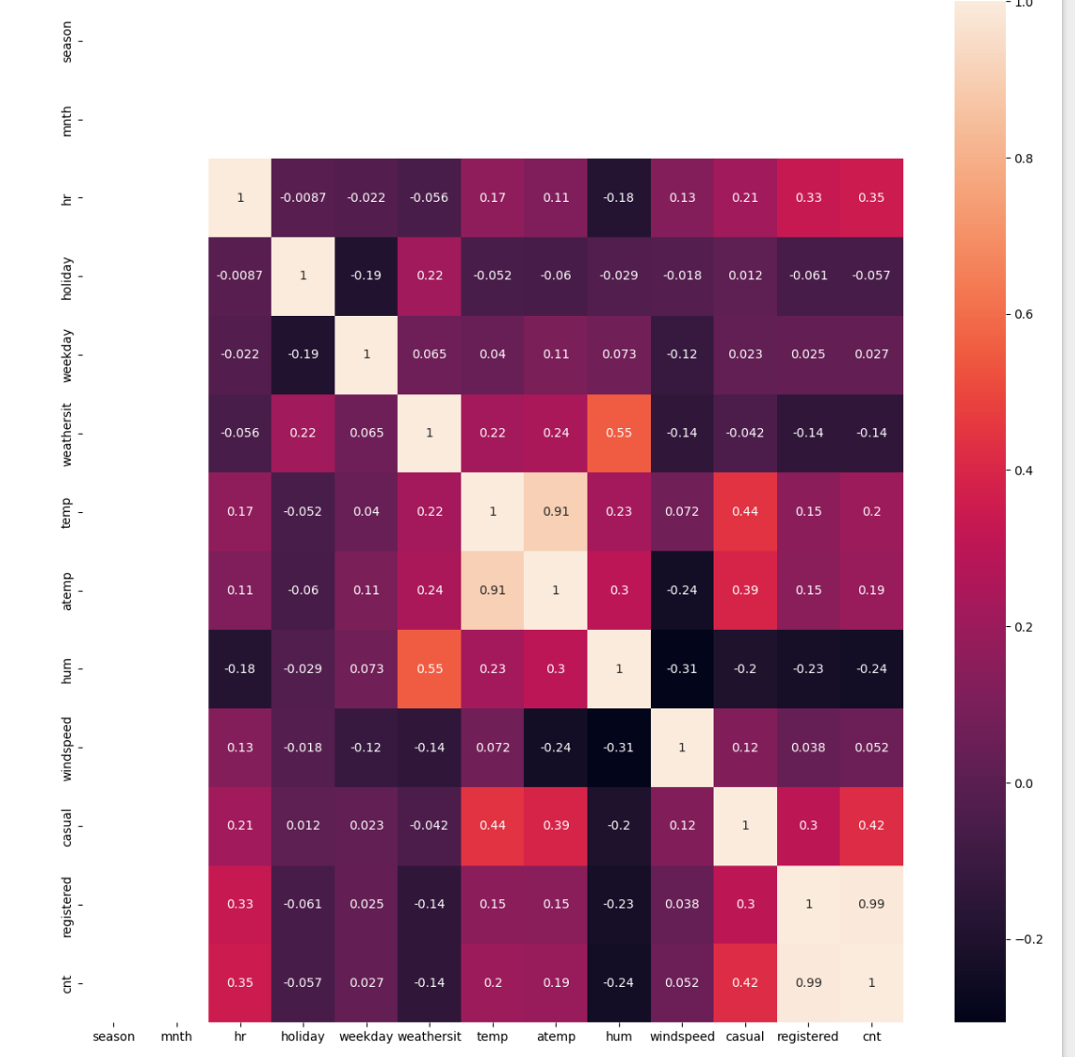
Finding correlation
Drawing heatmap to know relation between the values

Slide 11
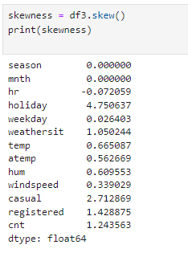
Finding skewness of the data

Slide 12
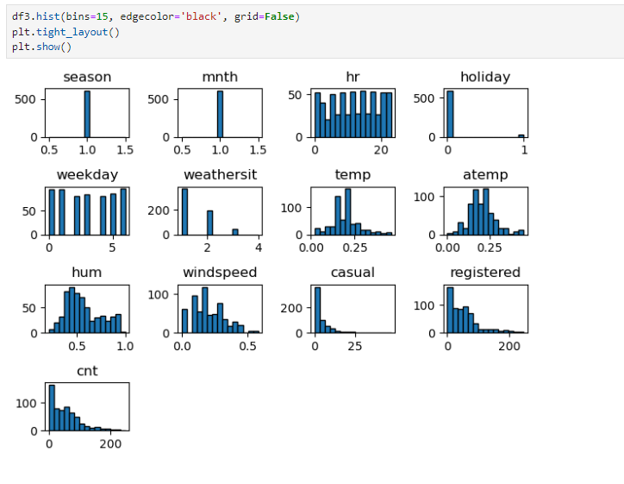
Visualizing in the form of histogram

Slide 13
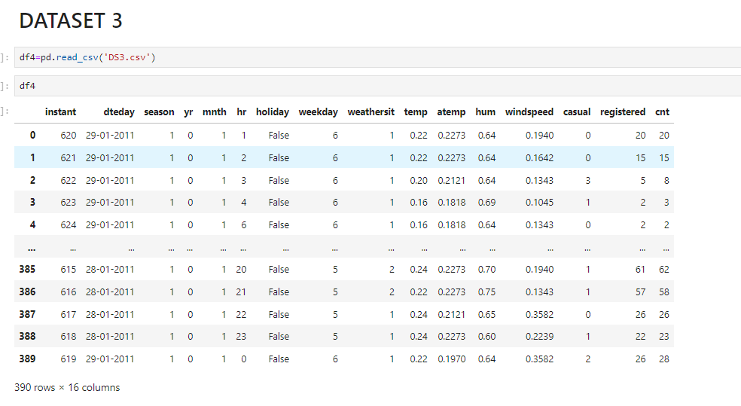
Data set 3

Slide 14
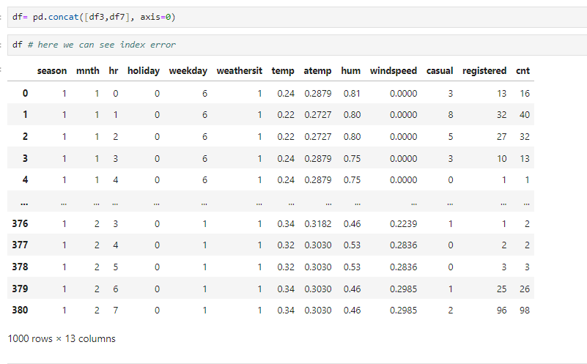
Concatenating dataset 1&2 combine with data set 3

Slide 15
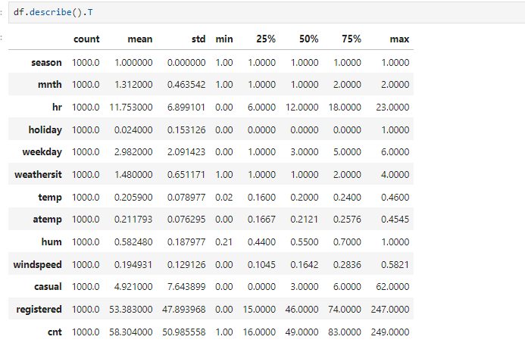
Understanding the data

Slide 16

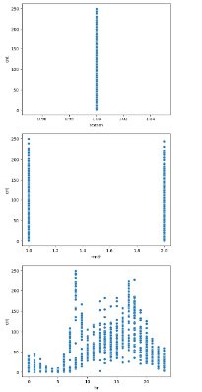
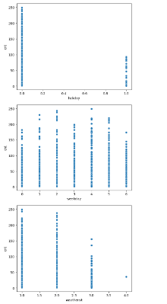
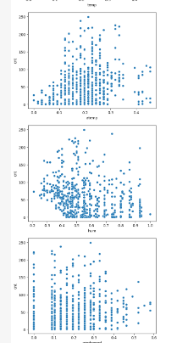
Plotting scatter plot

Slide 17
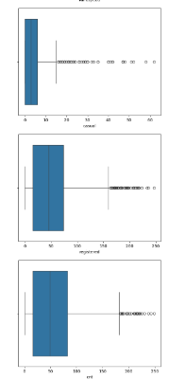
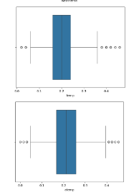
Finding outliers in the data set

Slide 18
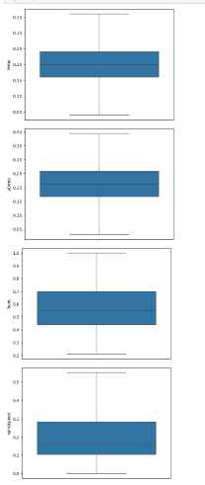
Fixing outliers
An outlier in data is a data point that significantly differs from the other data points in a dataset. Outliers can be unusually high or low values that fall outside the overall pattern of the data.

Slide 19
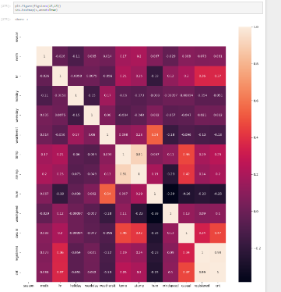
Finding correlation using heat map

Slide 20
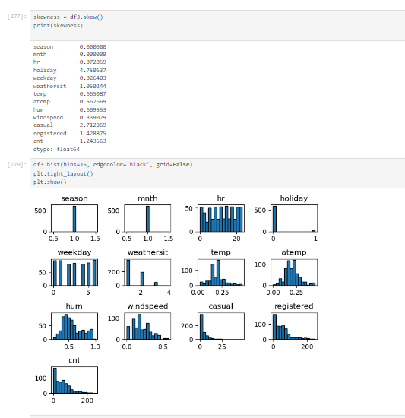
Skewness and histogram

Slide 21
Thank you
PrADEEP KUMAR CHAUHAN

